Slide 1
CAR Administration Overview
Module 3 – Root Cause Analysis

Slide 2
Setting Expectations with an example

Slide 3
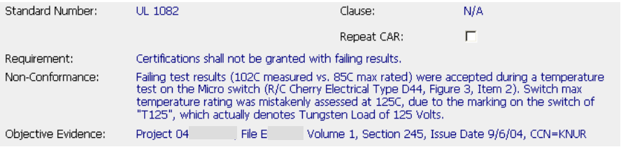
What would you expect from this CAR Owner?

Slide 4
What was done with the defective project? – Resolve the evidence
How widespread is the problem? – Scope of the problem
Are there any other projects with the same problem? – Exposure
Why did this happen? – Root Cause Analysis
5. How did this happen? – Detection
6. What can be done to stop this problem immediately? – Containment
7. What actions will be taken so this will not happen again? – Prevention
8. How will you know the solutions were successful? – Verification
How will you know it will not happen again? – Controls

Slide 5
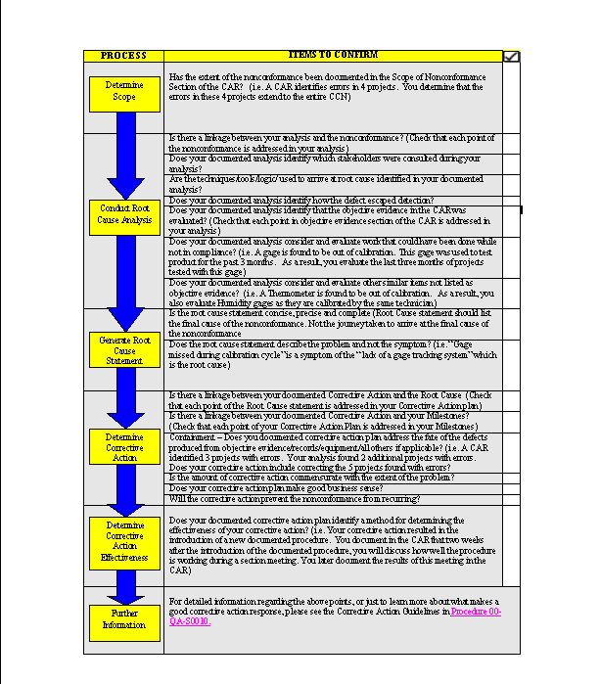
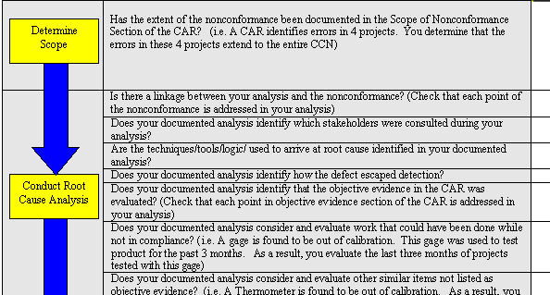
Job Aid –
Checklist for CAR Administrators and Owners
This Job Aid was developed to be used as a tool to help the CAR Owner and CAR Administrator ensure that all elements of the root cause analysis and corrective action plan are included in the CAR responses.
*Job Aid Checklist Items: Are identified in this presentation by this box.

Slide 6
Key Elements of appropriate Root Cause
INPUTS: Nonconformance and Objective Evidence
ACTIVITY: Analysis
  Identification of the stakeholders consulted
  Logical journey (and linkage) from nonconformance to the root cause statement
  Analysis of how defect escaped detection
  How scope of the nonconformance was determined including records evaluated
  Analysis of disposition of records and other nonconformances
OUTPUTS: Scope, Root Cause Statement, Corrective Action Plan
  Scope of the Nonconformance
    Describes full scope and impact of the nonconformance
    Includes records affected, geography
  Root Cause Statement
    Concise, precise, complete
    Not a restatement of symptoms
  Corrective Action Plan

Slide 7
Key Elements of appropriate Root Cause
INPUTS: Nonconformance and Objective Evidence
ACTIVITY: Analysis
  Identification of the stakeholders consulted
  Logical journey (and linkage) from nonconformance to the root cause statement
  Analysis of how defect escaped detection
  How scope of the nonconformance was determined including records evaluated
  Analysis of disposition of records and other nonconformances
OUTPUTS: Scope, Root Cause Statement, Corrective Action Plan
  Scope of the Nonconformance
    Describes full scope and impact of the nonconformance
    Includes records affected, geography
  Root Cause Statement
    Concise, precise, complete
    Not a restatement of symptoms
  Corrective Action Plan
Linkage from Nonconformance to Analysis
Linkage from Analysis to Root Cause Statement and Scope of Nonconformance
*Job Aid Checklist Items: “Is there a linkage between your analysis and the nonconformance?”

Slide 8
Analysis

Slide 9
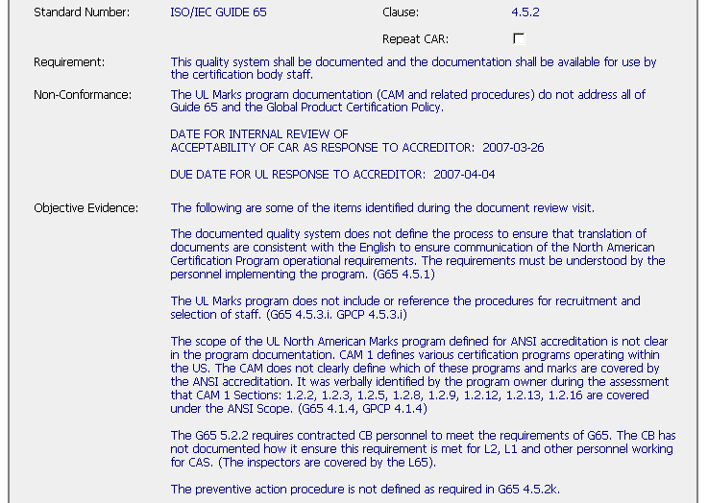
Finding versus Observation:
What problem is being solved?
Finding: Resolves the stated nonconformance, Root Cause Analysis, disposition of records, prevention
Observation: Resolves only the Objective Evidence, no analysis, and no prevention
Fixing Records alone does not prevent recurrence

Slide 10
Involvement of Stakeholders
Every process has stakeholders
  Those who supply inputs into the process
    Example: CAR Owners provide ‘inputs’ to the CAR process when they provide CAR responses
  Those who receive the output of the process
    Example: Internal Quality Auditors receive the ‘output’ of the CAR process to verify effectiveness
  Those who rely on the process and depend on it’s success and effectiveness
    Example: The CPO depends on the CAR process to help maintain their programs
Possible stakeholders for individual CARs
  Reviewers, Project Handlers
  Laboratory
  PDEs
  Staff at other locations or regions

Slide 11
Stakeholders
Don’t analyze the nonconformance in isolation
  Who has the best knowledge of the problem? (this person may be the CAR originator)
  Who has the best knowledge of the process?
  Who provides inputs to the process?
  Who receives outputs from the process?
*Job Aid Checklist Item: “Does your documented analysis identify which stakeholders were consulted during your analysis?”
Notes:
Person(s) having the best knowledge of the problem – may be the CAR originator
Try to find the process owner, if one exists (basic problem we still have at UL is that there are very few defined process owners)
If you are performing the step of the process where the nonconformance occurs, who provides information to you?
After you finish performing the part of the process where the nonconformance occurs, who receives your information?

Slide 12

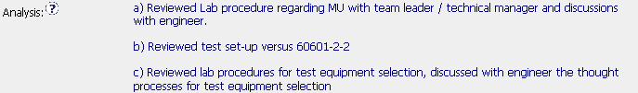
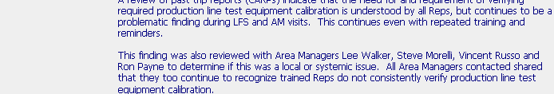
Stakeholders
Examples of interaction with stakeholders

Slide 13
Some Root Cause Analysis Methodologies
Five Whys
  Continue asking “Why?” until the answer is “I don’t know”
Occurrence Cause Mapping
  What went wrong?
Brainstorming
  Technique for gathering lots of ideas from stakeholders
Cause-and-Effect or Fishbone Diagrams
  Visual method to organize ideas and see relationships
Pareto Diagrams
  Tool for analyzing the data that has been collected
*Job Aid Checklist Item: “Are the techniques/tools/logic/ used to arrive at root cause identified in your documented analysis?”
Notes:
Five Whys – simple method, easy to understand
Occurrence Cause Mapping – stepping through exactly what went wrong, almost like a flow chart of how the nonconformance happened
Brainstorming – Generates lots of ideas; generally need to use another tool (Cause-and-Effect, Pareto, etc.) to further refine and organize
Cause-and-Effect Diagram – good tool for organizing ideas in order to group and relate
Pareto Diagrams – another way to refine and organize facts or data

Slide 14
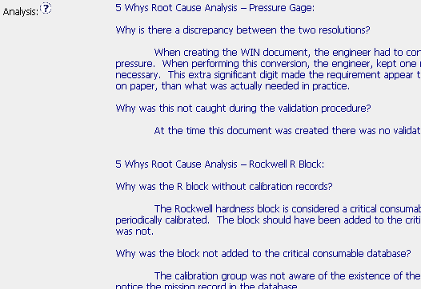
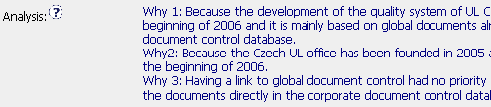
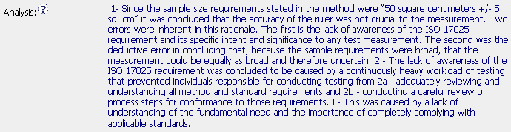
Root Cause Analysis Methodologies
Variations of the classic “5 Whys”
Occurrence Cause Mapping

Slide 15
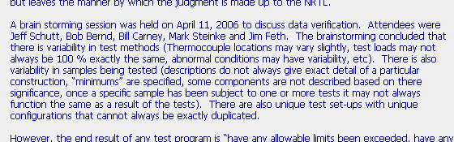
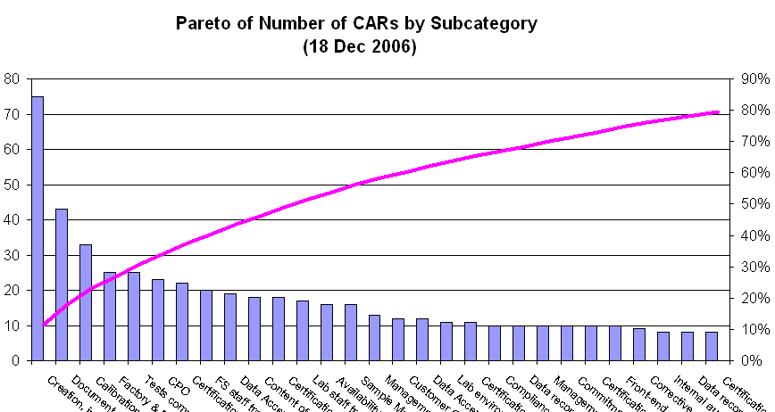
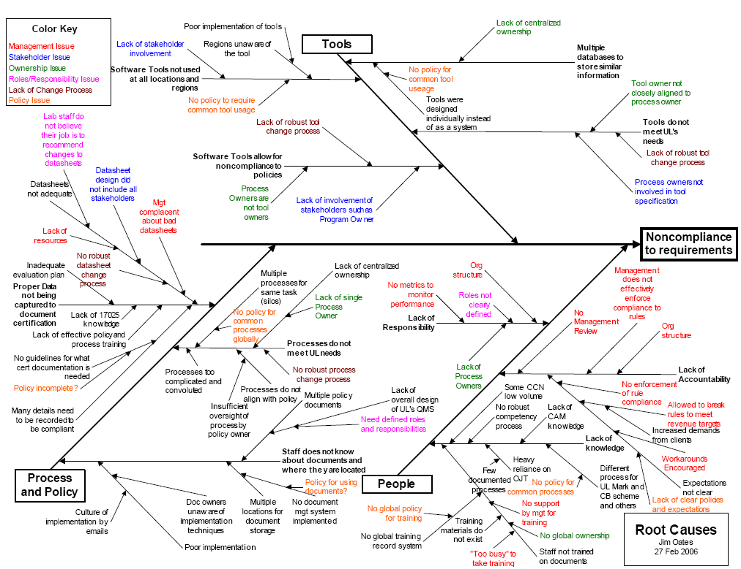
Root Cause Analysis Methodologies
Brainstorming Session
Pareto Analysis
Cause-and-Effect Diagram

Slide 16

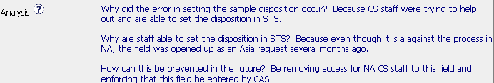
How did the defect escape?
Reviewer and handler were misled by similarity of the data
Item was being entered outside of the process by incorrect personnel
*Job Aid Checklist Item: “Does your documented analysis identify how the defect escaped detection?”

Slide 17
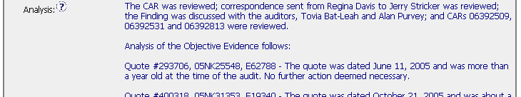
Disposition of Records
Root cause investigation includes an analysis of the records cited in the Objective Evidence of the nonconformance
*Job Aid Checklist Item: “Does your documented analysis identify that the objective evidence in the CAR was evaluated?”

Slide 18

Disposition of Records
Analysis must consider other records that may also be defective but not identified in the Objective Evidence
a
b
c
*Job Aid Checklist Item: “Does your documented analysis consider and evaluate work that could have been done while not in compliance?”

Slide 19
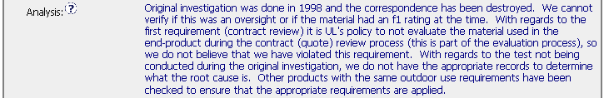
Disposition of Records
Analysis should also consider other areas and records that may have the problem but were not included in the Objective Evidence
1
2
*Job Aid Checklist Item: “Does your documented analysis consider and evaluate other similar items not listed as objective evidence?”

Slide 20
Result of the Analysis –
Scope of the Nonconformance

Slide 21
Elements of the Scope of Nonconformance
Defines the Functional Groups affected
Describes the records affected
Provides indication of the locations affected
Scope is determined during the analysis because the CAR’s Objective Evidence does not describe the entire scope of the problem

Slide 22
Importance of defining the
Scope of the Nonconformance
Shows the extent of the problem
Need to know the scope to properly identify the areas where the corrective actions need to be applied.
This is an area for improvement
*Job Aid Checklist Item: “Has the extent of the nonconformance been documented in the Scope of Nonconformance Section of the CAR?”

Slide 23


Review these Scopes of Nonconformances
1.
2.
1.
1.
1.
3.
4.
5.
6.
7.
The Scope of the Nonconformance should describe. . .
    Who was affected: Groups, individuals affected
    Where: Locations, regions, sectors with the problem
    What: Records are affected
    How widespread

Slide 24
Review these Scopes of Nonconformances
1.
What reviews? Where?
2.
1.
1.
1.
3.
4.
5.
6.
7.
The Scope of the Nonconformance should describe. . .
    Who was affected: Groups, individuals affected
    Where: Locations, regions, sectors with the problem
    What: Records are affected
    How widespread

Slide 25
Review these Scopes of Nonconformances
1.
What reviews? Where?
2.
1.
Restates the requirement, not exposure.
1.
1.
3.
4.
5.
6.
7.
The Scope of the Nonconformance should describe. . .
    Who was affected: Groups, individuals affected
    Where: Locations, regions, sectors with the problem
    What: Records are affected
    How widespread

Slide 26
Review these Scopes of Nonconformances
1.
What reviews? Where?
2.
1.
Restates the requirement, not exposure.
1.
1.
3.
How “common”? Locations?
4.
5.
6.
7.
The Scope of the Nonconformance should describe. . .
    Who was affected: Groups, individuals affected
    Where: Locations, regions, sectors with the problem
    What: Records are affected
    How widespread

Slide 27
Review these Scopes of Nonconformances
1.
What reviews? Where?
2.
1.
Restates the requirement, not exposure.
1.
1.
3.
How “common”? Locations?
4.
This is a requirement. How widespread is the problem?
5.
6.
7.
The Scope of the Nonconformance should describe. . .
    Who was affected: Groups, individuals affected
    Where: Locations, regions, sectors with the problem
    What: Records are affected
    How widespread

Slide 28
Review these Scopes of Nonconformances
1.
What reviews? Where?
2.
1.
Restates the requirement, not exposure.
1.
1.
3.
How “common”? Locations?
4.
This is a requirement. How widespread is the problem?
5.
What locations? How widespread?
6.
7.
The Scope of the Nonconformance should describe. . .
    Who was affected: Groups, individuals affected
    Where: Locations, regions, sectors with the problem
    What: Records are affected
    How widespread

Slide 29
Review these Scopes of Nonconformances
1.
What reviews? Where?
2.
1.
Restates the requirement, not exposure.
1.
1.
3.
How “common”? Locations?
4.
This is a requirement. How widespread is the problem?
5.
What locations? How widespread?
6.
Better scope.
7.
The Scope of the Nonconformance should describe. . .
    Who was affected: Groups, individuals affected
    Where: Locations, regions, sectors with the problem
    What: Records are affected
    How widespread

Slide 30
Review these Scopes of Nonconformances
1.
What reviews? Where?
2.
1.
Restates the requirement, not exposure.
1.
1.
3.
How “common”? Locations?
4.
This is a requirement. How widespread is the problem?
5.
What locations? How widespread?
6.
Better scope.
7.
Better scope.
The Scope of the Nonconformance should describe. . .
    Who was affected: Groups, individuals affected
    Where: Locations, regions, sectors with the problem
    What: Records are affected
    How widespread

Slide 31
Result of the Analysis –
Root Cause Statement

Slide 32
Root Cause Statement Summary
Concise, lists the true root cause and does not restate the symptoms
Linkage - There must be a logical connection from the requirement to the nonconformance to the root cause statement
Be wary of “lack of knowledge”, “human error”, “item overlooked” and “inadequate training” as root causes
Every problem needs a root cause statement
*Job Aid Checklist Items: “Is the root cause statement concise, precise and complete?
Does the root cause statement describe the problem and not the symptom?”
Notes:
Usually, the root cause should be only one or two sentences. If you start writing more than that, you probably are restating symptoms or analysis, and have not truly identified the root cause.
You must make sure that you have addressed the actual problem that was observed; linkage will help to show this
All of these “excuses” require asking another “Why?”
If there was a problem, there must be a root cause
Frustration, aggravation, and embarrassment

Slide 33


Examples - Root Causes
A
B
C

Slide 34
Examples - Root Causes
“Potential” is not a root cause.
A
B
C
Notes:
A – If you use words like “potential” or other such imprecise words, you have not identified the true root cause
B – Root Cause is really little more than a restatement of the nonconformance; why were there not training requests?
C - Acceptable

Slide 35
Examples - Root Causes
“Potential” is not a root cause.
A
B
A restatement of nonconformance is not a root cause.
C
Notes:
A – If you use words like “potential” or other such imprecise words, you have not identified the true root cause
B – Root Cause is really little more than a restatement of the nonconformance; why were there not training requests?
C - Acceptable

Slide 36
Examples - Root Causes
“Potential” is not a root cause.
A
B
A restatement of nonconformance is not a root cause.
C
Better root cause
Notes:
A – If you use words like “potential” or other such imprecise words, you have not identified the true root cause
B – Root Cause is really little more than a restatement of the nonconformance; why were there not training requests?
C - Acceptable

Slide 37
Technique – Anticipate the Root Causes
While reading the nonconformance:
  Consider the possible reasons why this nonconformance could have occurred.
  Determine the ‘why’ questions you would like answered.
  Try to answer those ‘why’ questions based on your knowledge and experience.
When reviewing the root cause:
  Were your ‘why’ questions answered?
  Does the stated root cause seem plausible?
  Is it a ‘Root Cause’ or just an excuse?
Get inside the mind of the CAR Owner

Slide 38
Example A – Anticipate the Root Cause
Stated Nonconformance:
Root Cause:
Expectations?

Slide 39
Example A – Anticipate the Root Cause
Stated Nonconformance:
Root Cause:
Expectations:
Reasons why the compressor data for Model 8 was missing.
Reasons why the rationale for acceptance of this data was not provided.

Slide 40
Example A – Anticipate the Root Cause
Stated Nonconformance:
Root Cause:
Expectations:
Reasons why the compressor data for Model 8 was missing.
Reasons why the rationale for acceptance of this data was not provided.
Actual:
??

Slide 41
Example B – Anticipate the Root Cause
Stated Nonconformance:
Root Cause:
Expectations?

Slide 42
Example B – Anticipate the Root Cause
Stated Nonconformance:
Root Cause:
Expectations:
Why are different units of measure used?
Since units are different, is there an issue with the calibration?

Slide 43
Example B – Anticipate the Root Cause
Stated Nonconformance:
Root Cause:
Expectations:
Why are different units of measure used?
Since units are different, is there an issue with the calibration?
Actual:
??

Slide 44
Example C – Anticipate the Root Cause
Stated Nonconformance:
Root Cause:
Expectations?

Slide 45
Example C – Anticipate the Root Cause
Stated Nonconformance:
Root Cause:
Expectations:
Is the product a ‘display unit’? If so, why did the product description not state this?
If the product is not a ‘display unit’, where is the data? Why missing?

Slide 46

Example C – Anticipate the Root Cause
Stated Nonconformance:
Root Cause:
Expectations:
Is the product a ‘display unit’? If so, why did the product description not state this?
If the product is not a ‘display unit’, where is the data? Why missing?
Actual:
??

Slide 47
Example D – Anticipate the Root Cause
Stated Nonconformance:
Root Cause:
Expectations?

Slide 48
Example D – Anticipate the Root Cause
Stated Nonconformance:
Root Cause:
Expectations:
Where are the thermocouple locations? Are these failing test results?
Reasons why the rationale for acceptance of this data was not provided.

Slide 49
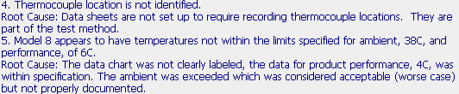
Example D – Anticipate the Root Cause
Stated Nonconformance:
Root Cause:
Expectations:
Where are the thermocouple locations? Are these failing test results?
Reasons why the rationale for acceptance of this data was not provided.
Actual:
??

Slide 50

Group Discussion –
Would you accept this root cause?

Slide 51
Group Discussion –
Would you accept this root cause?
Where is the proof? Is it in the Analysis?

Slide 52

Group Discussion –
Would you accept this root cause?

Slide 53
Group Discussion –
Would you accept this root cause?
This says “They didn’t know because they didn’t know” – NOT a root cause!

Slide 54
Group Discussion –
Would you accept this root cause?

Slide 55
Group Discussion –
Would you accept this root cause?
“Possible error” – Needs more work to complete the analysis.

Slide 56
Group Discussion –
Would you accept this root cause?

Slide 57
Group Discussion –
Would you accept this root cause?
How do we know? – More analysis needed to confirm. What if the reason for this nonconformance is still occurring today?

Slide 58

Root Cause Warning Bells
“Lack of resources”
“Inadequate training” or “Lack of training”
“Did not understand, was not aware”
“Potential” or “Possible” – indication that investigation was not completed
“This is not a finding”
“Isolated incident”
“Person has left the company” so problem no longer exists
“Human Error”

Slide 59
Root Cause Warning Bells
“Lack of resources” ← Solution needs to be: Get more resources!
“Inadequate training” or “Lack of training” ← Why?
“Did not understand, was not aware” ← Why?
“Potential” or “Possible” – indication that investigation was not completed ←Finish
“This is not a finding” ← Why?
“Isolated incident” ← How do you know?
“Person has left the company” so problem no longer exists ← Really?
“Human Error” ← Why? Can error-proofing eliminate?

Slide 60
Observation Response Requirements
A. Observation that documents a record not in compliance
  CAR response is required – the corrective action plan and associated milestone(s) must be completed, “not applicable” (or similar) in all other required fields.
  Objective evidence that the record has been addressed is required as objective evidence before the CAR can be closed.
B. Suggestions for Improvement
  Noted as a suggestion in the the nonconformance section
  The Owner decides whether to respond
  Document that decision in the CAR’s Root Cause Analysis field
  Observations can be forced closed by the CAR Administrator after an acceptable implementation has been received.

Slide 61
Root Cause Summary
Analysis
  Consult with stakeholders
  Document the thought-process used to determine the cause
  Describe how defect escaped detection
Results of Analysis
  Scope of the nonconformance – Is it isolated or widespread? (this should include a description of the records evaluated to determine scope)
  Root Cause Statement – Clear, concise statement of the cause of the nonconformance.
Notes:
Now that a nonconformance has been properly documented, it is time for the owner to start analyzing the problem in order to determine the root cause and to develop corrective action.
We’ll go through these aspects in more detail in the following slides.

Slide 62
End of Module 3
Revision 1.0 – Version presented to EULA team June 2007, complies with 00-QA-S0010 Issue 6.0 and 00-QA-J0029 Issue 1.0.

